Slide 1

SmartBuy Mobile App for Drivers

Slide 2
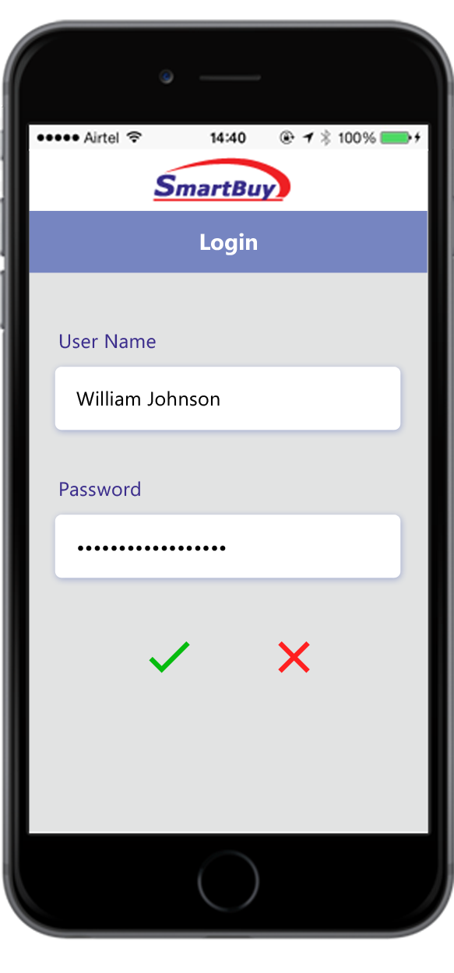
Login Screen
System will prompt for credentials first time. Subsequent times system remembers and validates credentials each time the driver launches the app.

Slide 3
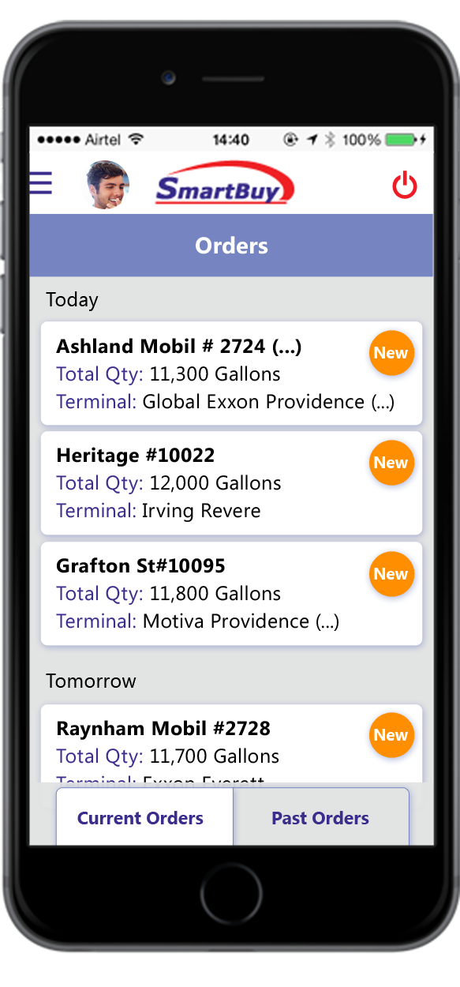
Order List
Tapping on order will take user to order details screen

Slide 4
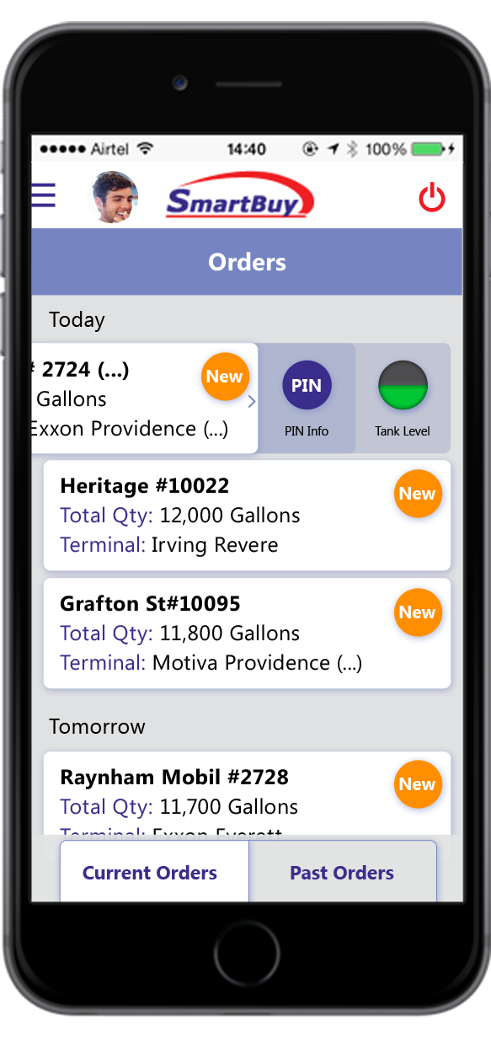
Order List
When order is swiped left, icons for tank levels and PIN are available.

Slide 5
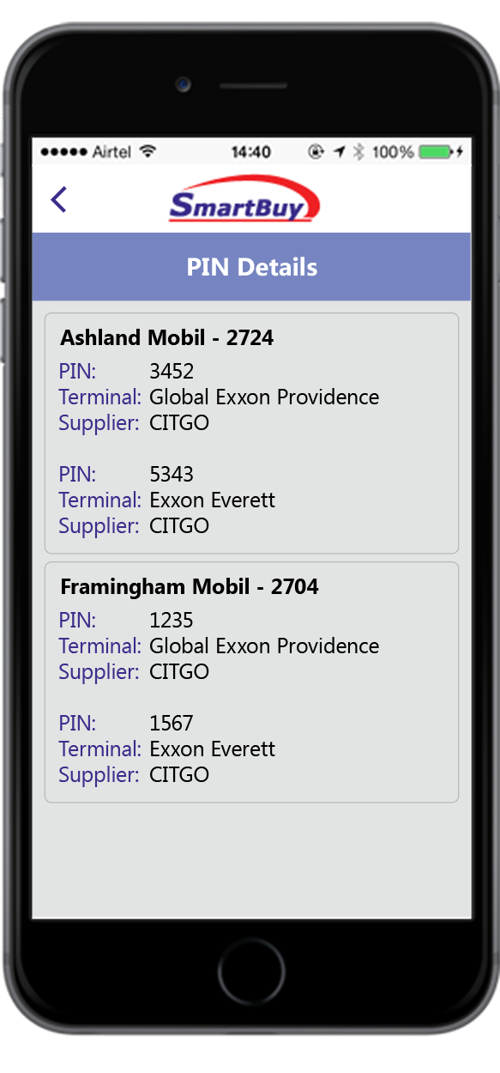
PIN details

Slide 6
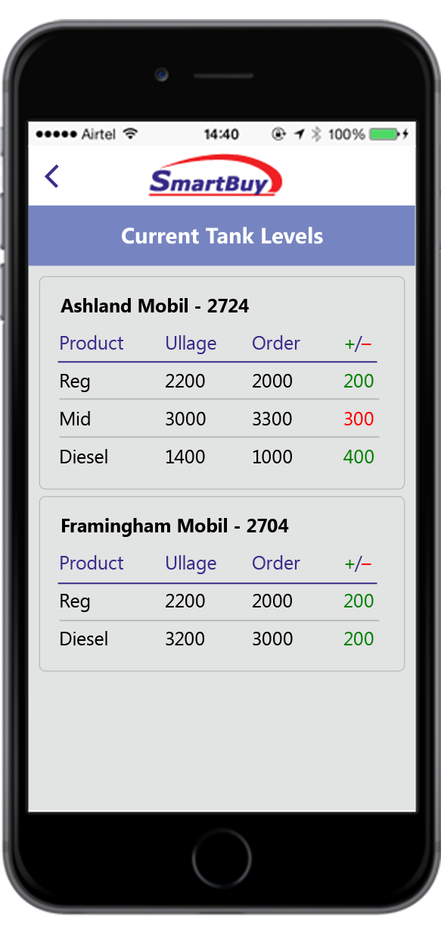
Tank Levels
Ullage values are real time assuming a interface to insite 360 exists to provide real time tank levels
+/- shows difference of Ullage & ordered Qty

Slide 7
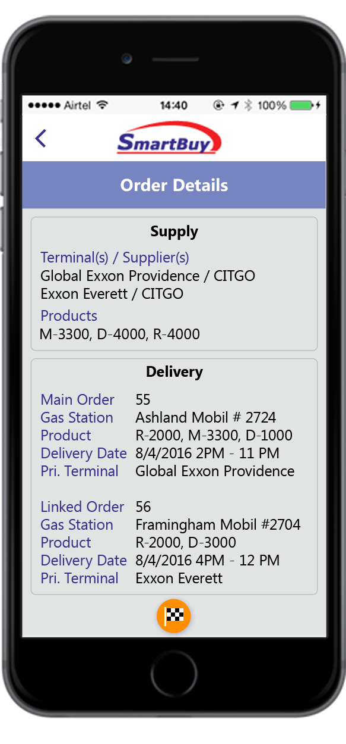
Order Details
Tap to Start

Slide 8
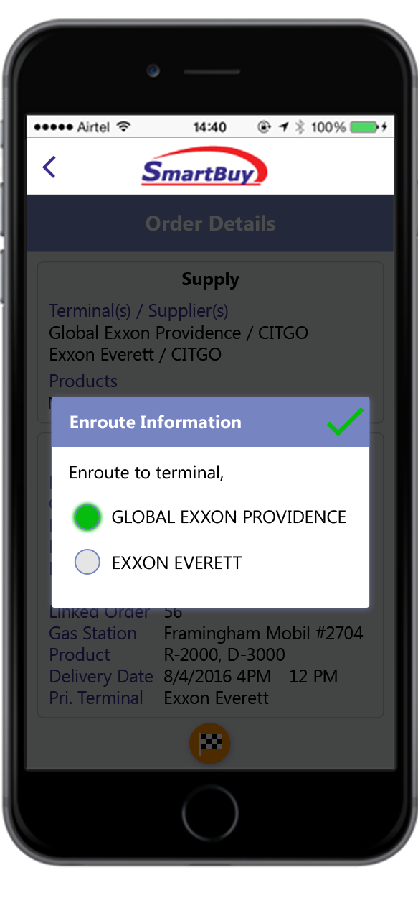
Status Update - Started
For multi lift order, User is prompted to enter terminal he is headed to

Slide 9

Order List
Tap to enter wait or lift information

Slide 10
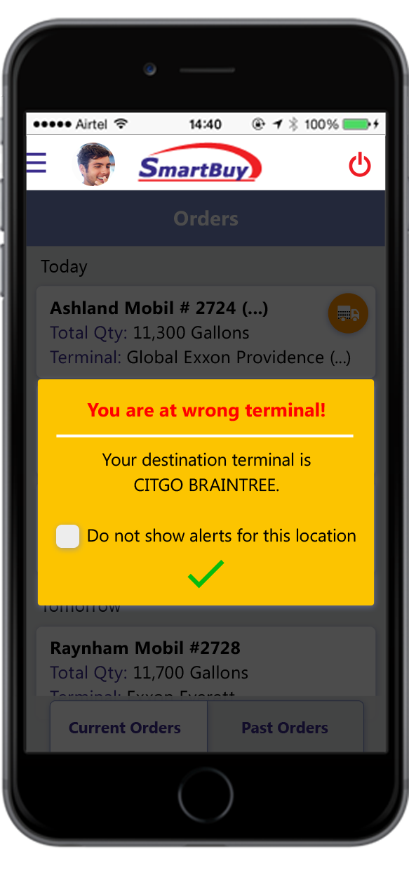
Notifications - Wrong Location
Alert will be given if driver is at wrong terminal. Similar alert if driver is at wrong site.
When checked, alerts will not be displayed for this location.

Slide 11
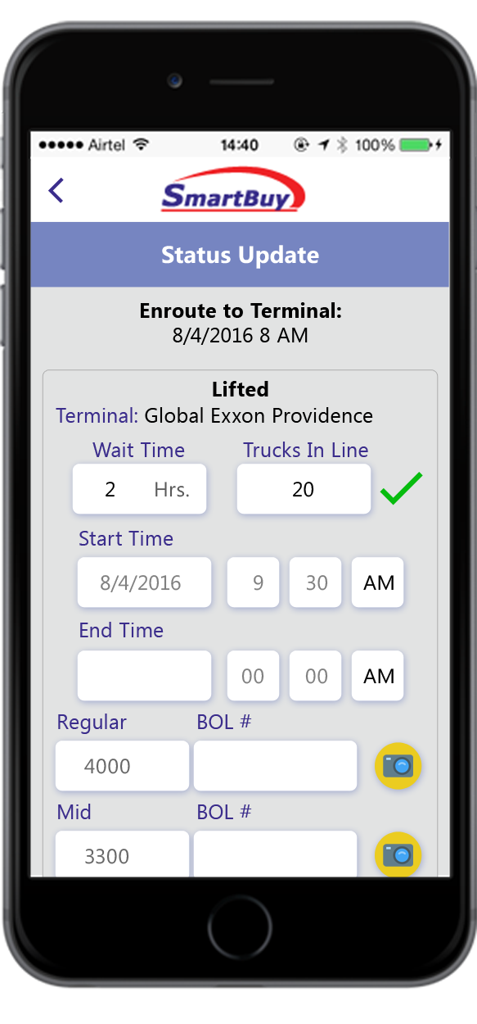
Order List – Status Update-Wait times
Wait Information

Slide 12
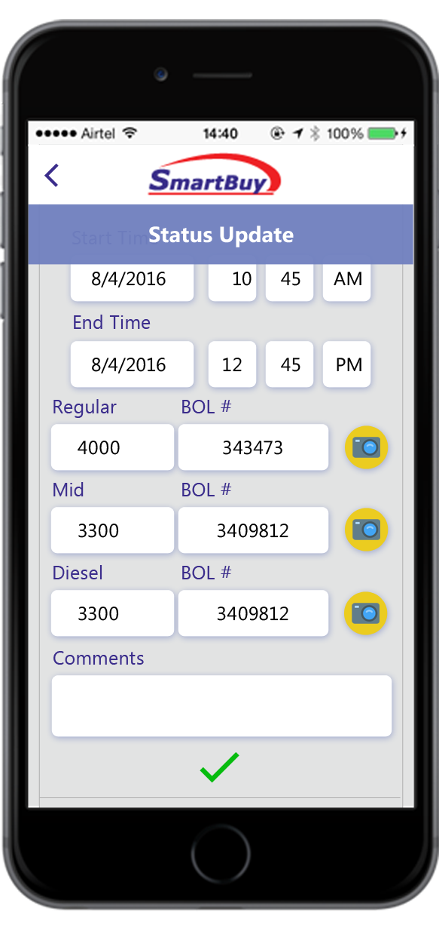
Order List – Status Update- Lifted
Lift Start and End times will be defaulted. BOL numbers can be defaulted if G3 interface exists. Driver can override the above values.
Tap to take BOL picture

Slide 13

Order List
Order is partially lifted. Tap to enter next lift information

Slide 14
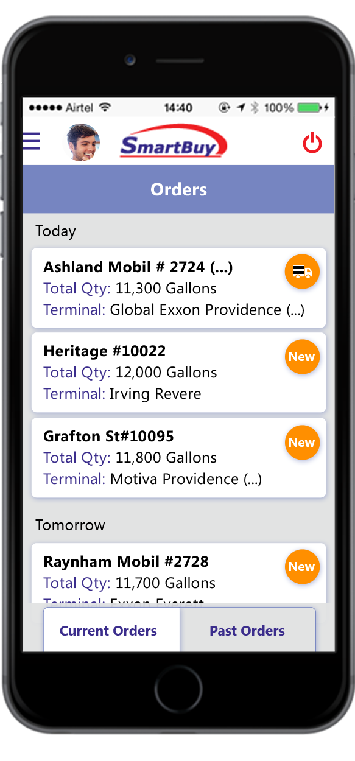
Order List
Fully lifted order. Tap to enter delivery information

Slide 15
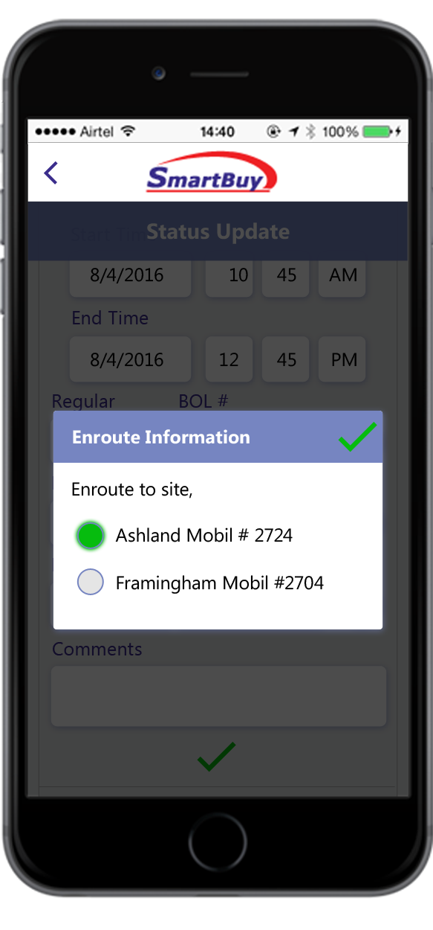
Route Information
If order is multi stop, after lifting at all terminals, driver will be prompted o select site he is headed to.

Slide 16
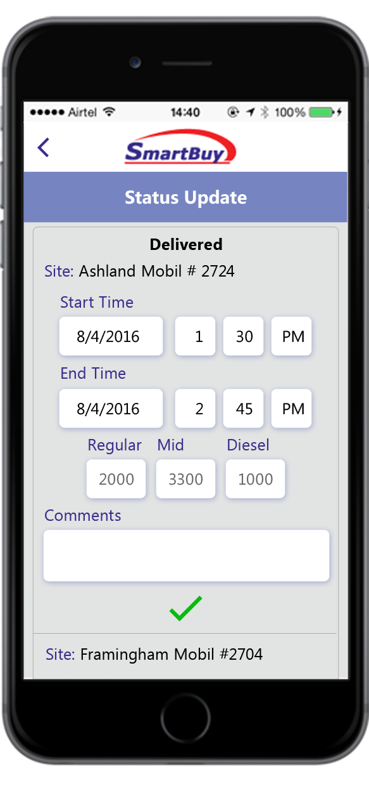
Order List – Status Update- Delivered
Start and end times, quantities will be defaulted. Driver will have ability to override

Slide 17
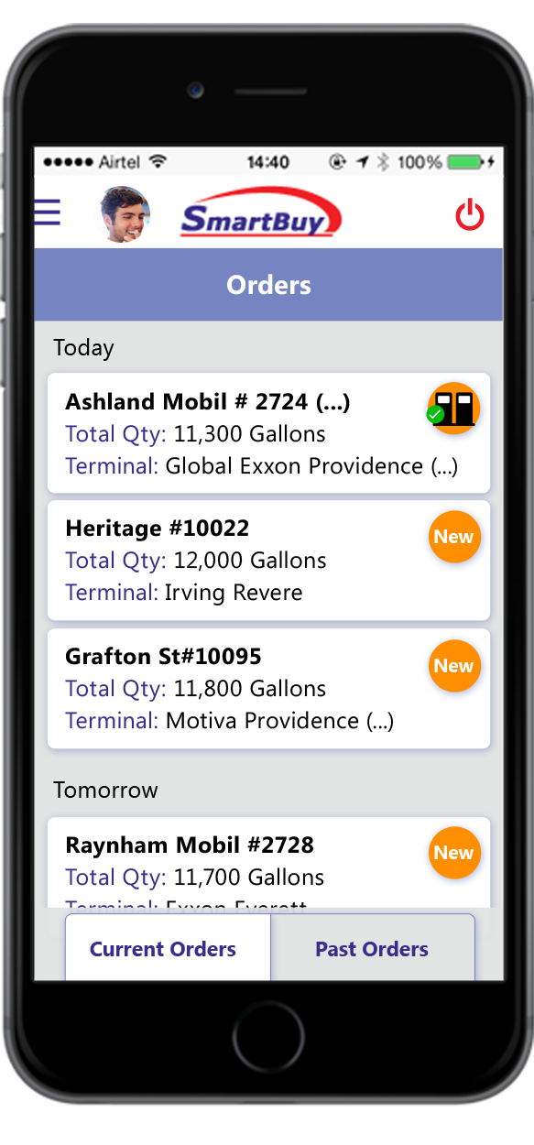
Order List – Status Update- Delivered
For multi stop orders, tap to enter second delivery details

Slide 18
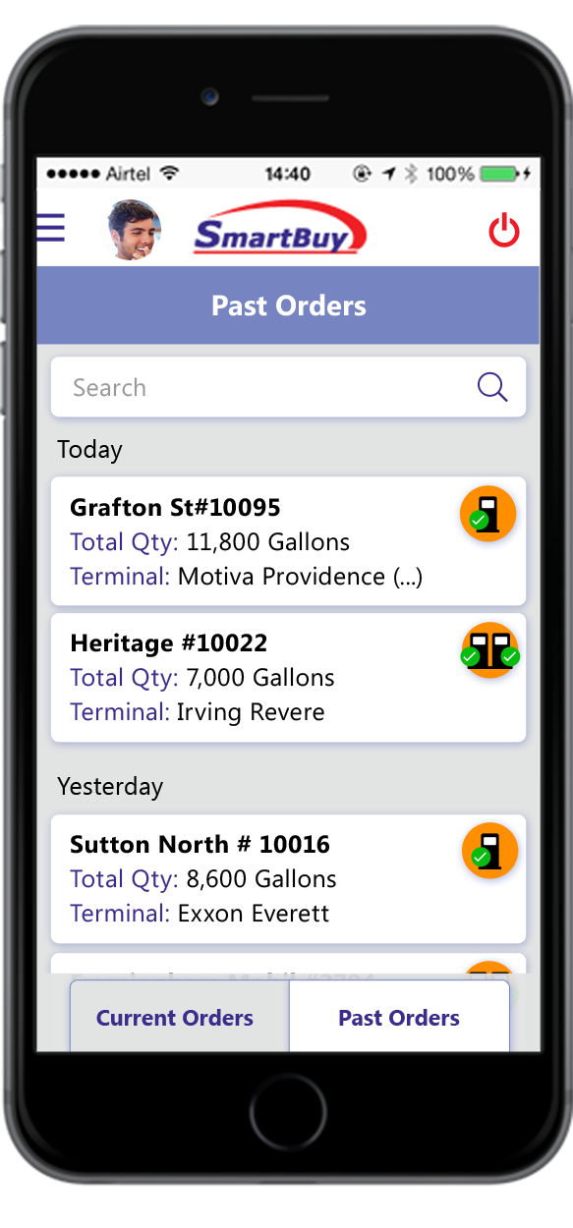
Past Orders

Slide 19
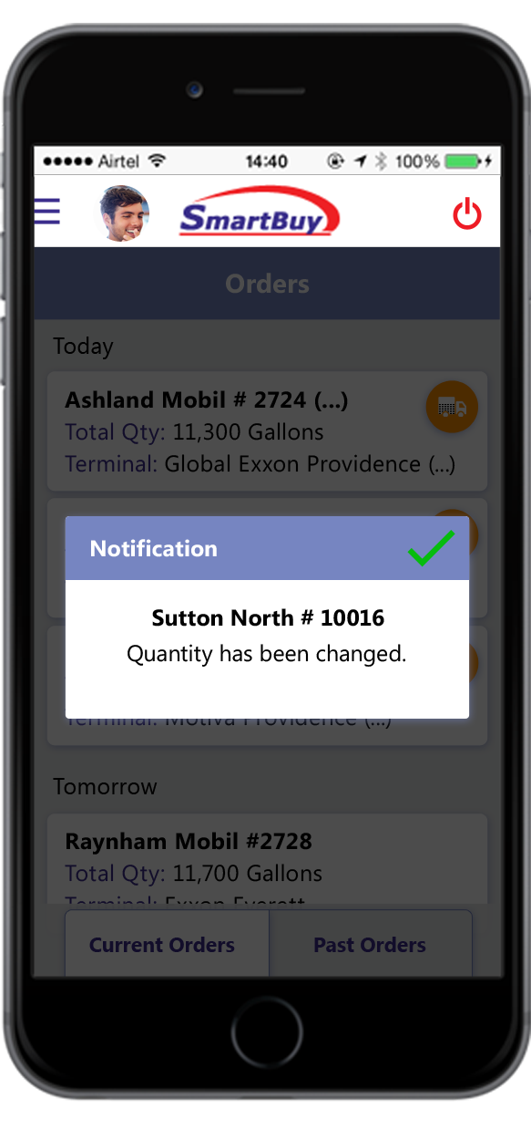
Notifications
Driver will get notified of any new orders and changes

Slide 20
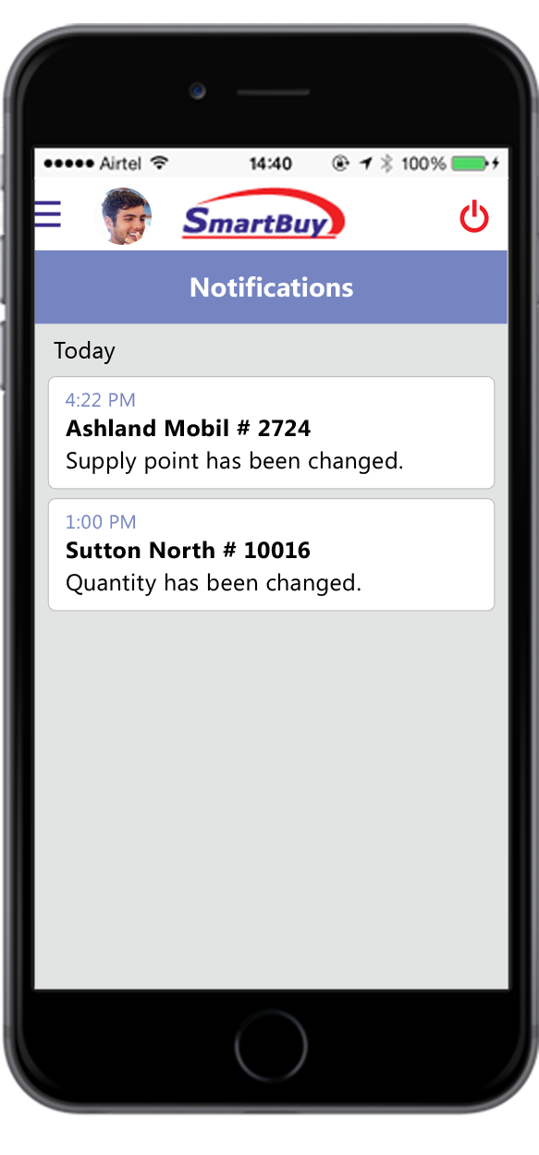
Notifications Menu
Opens order details screen when tapped

Slide 21
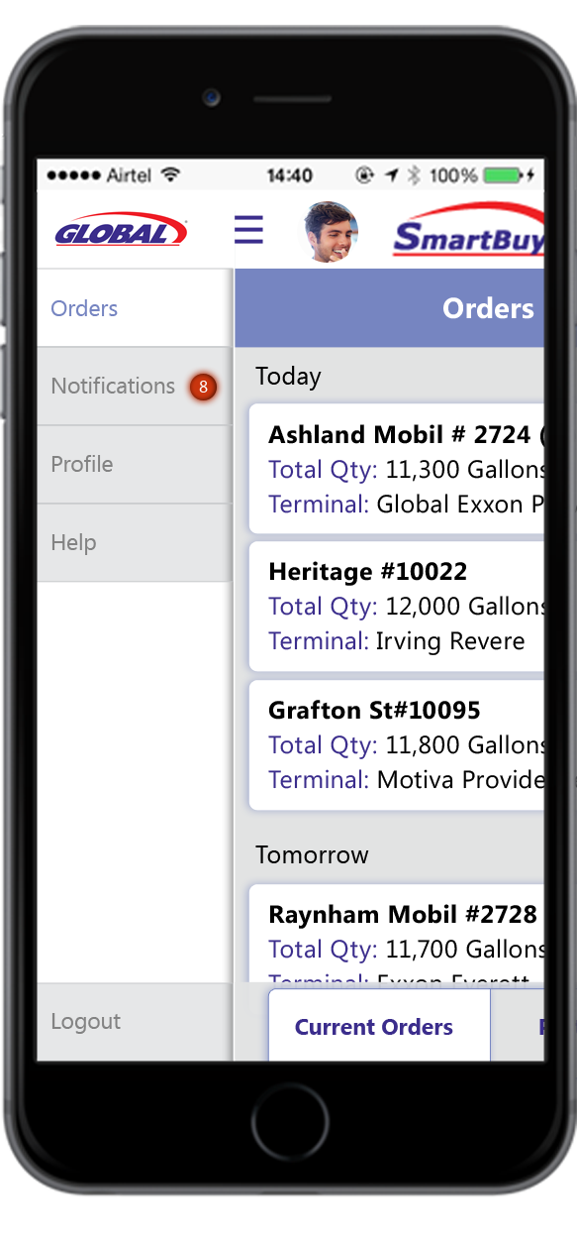
Menu

Slide 22
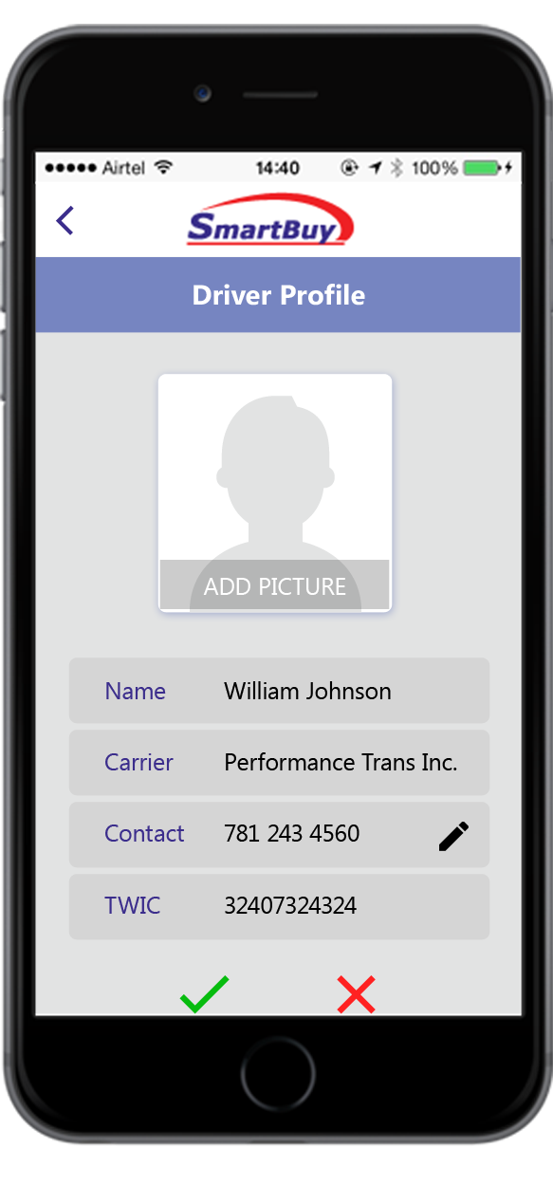
User Profile
Driver can add image to his profile

Slide 23
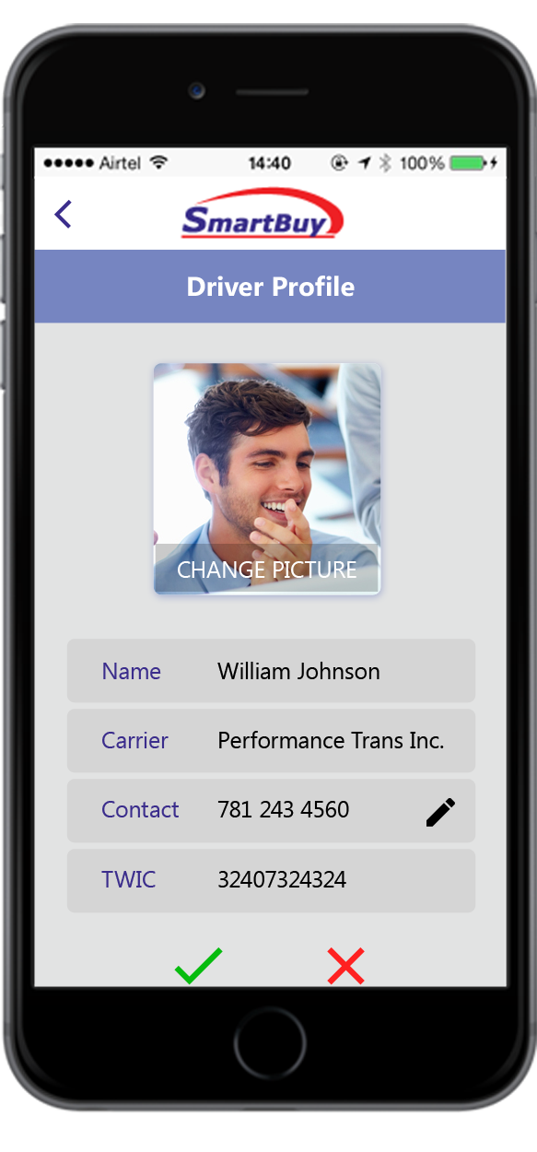
User Profile
Driver can change image

Slide 24









Legend - Status
Indicates that order is New
Tap to change status to Enroute to Terminal
Indicates that truck is Enroute to Terminal. Tap to enter Wait or Lift information
Partially Lifted. Tap to enter more lift information
Tap to launch camera to take BOL picture
Fully Lifted
Partially Delivered
Fully Delivered

Slide 25
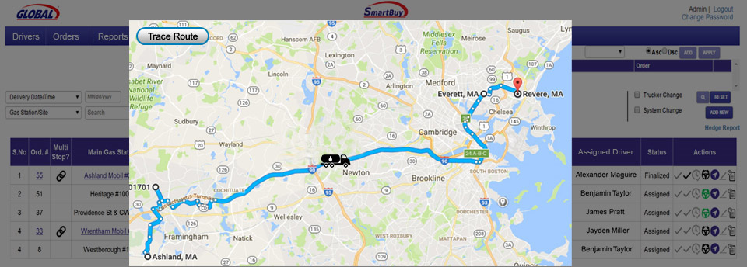
Drivers Location
By clicking on ‘Trace Route’ the user can view the time and location of the driver at any given point in time between the start time and the delivery time

Slide 26
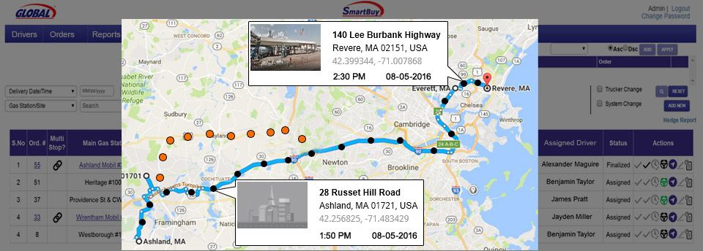
Track Load By Route
By clicking on the dots the user can view the time and location of the truck. This is to track the route and the time taken by the driver.
This orange dots show deviation

Slide 27
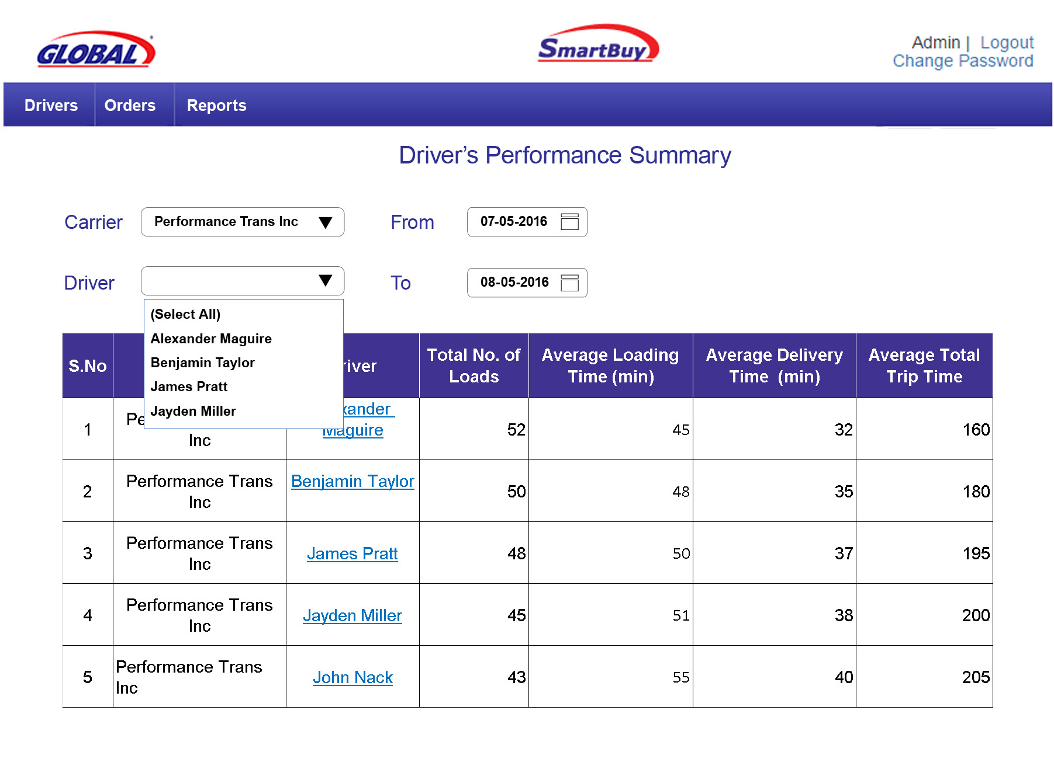
When A Global User Generates Driver’s Performance Report
The drivers column is a hyper link. When clicked we can view the orders of that particular driver
The Global User can look at the drivers performance report by the time taken by the driver to load, deliver the load and the total trip time
The Global user can select a single driver, multiple drivers or all the drivers to view the performance

Slide 28
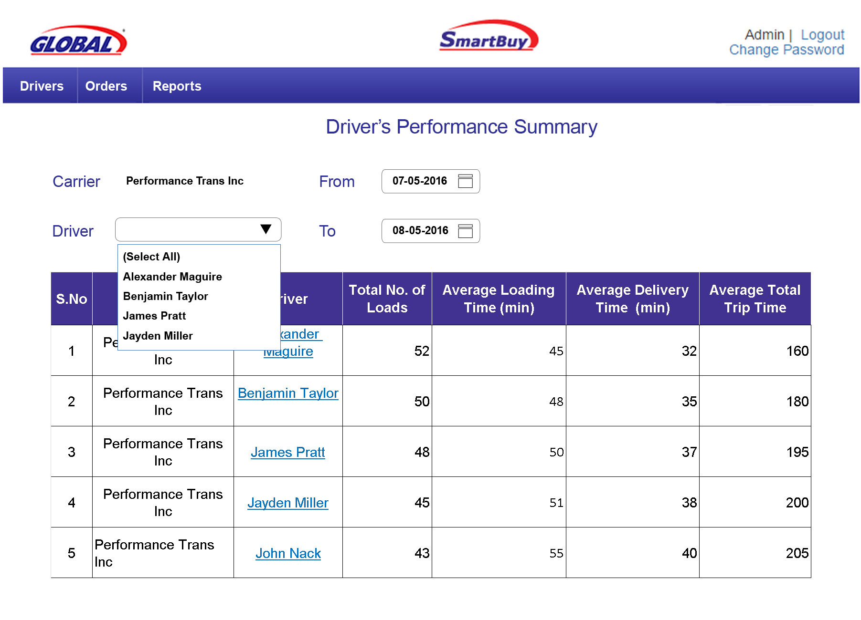
When a Carrier generates the Driver’s Performance Report
The drivers column is a hyper link. When clicked we can view the orders of that particular driver
The carrier can look at the drivers performance report by the time taken by the driver to load, deliver the load and the total trip time
The career can select a single driver, multiple drivers or all the drivers to view the performance

Slide 29
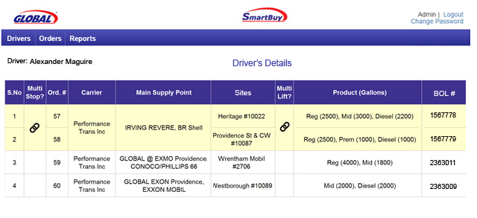
Driver’s Detailed Report
The user can see the particular driver’s order details here for the selected period in the previous screen

Slide 30
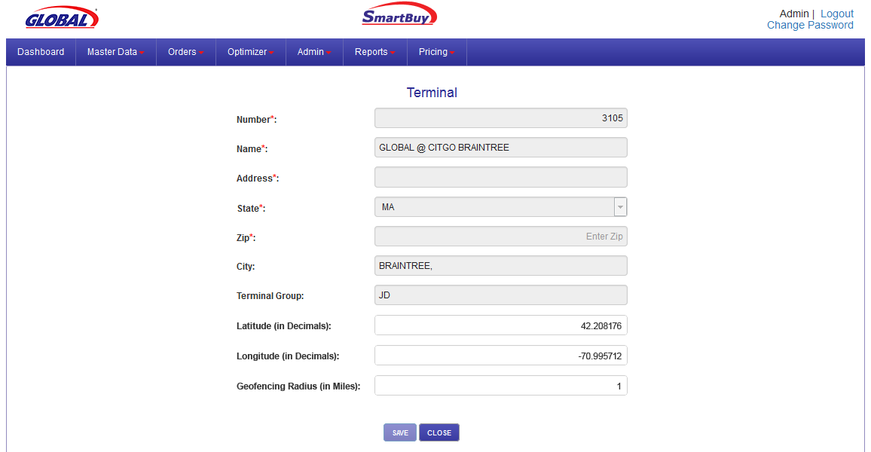
Master Data - Terminals
Lat long values will be defaulted and can be overridden
Geofencing radius specified here will override the value in Global settings

Slide 31
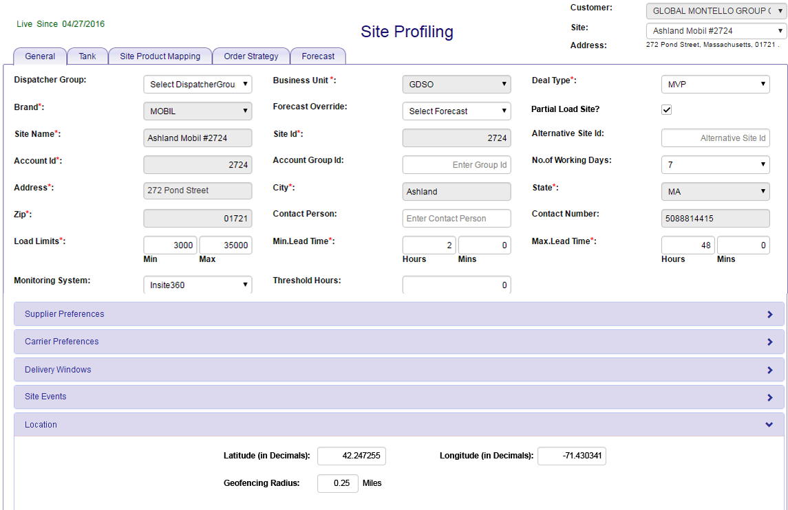
Master Data - Sites
Geo-fencing radius specified here will override the value in Global settings
Lat long values will be defaulted and can be overridden

Slide 32
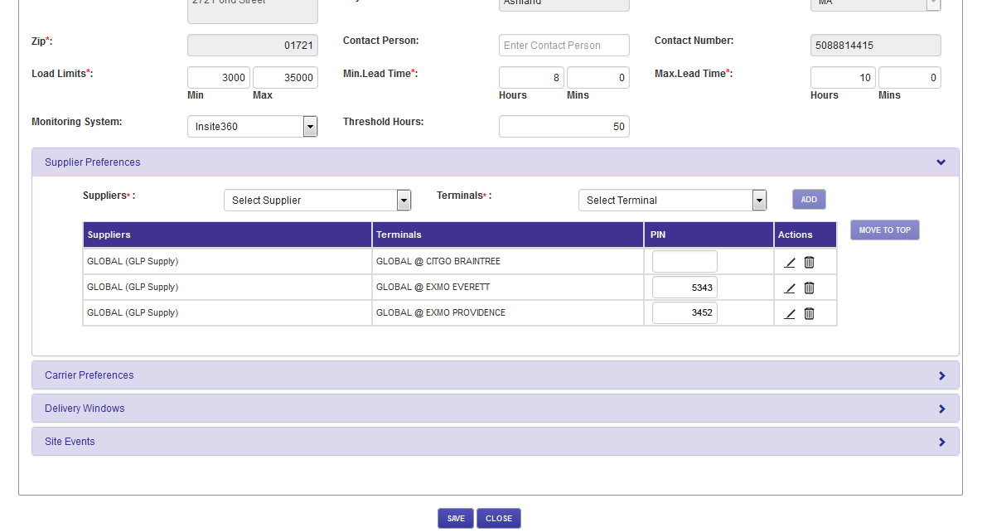
Master Data – Sites
For branded sites, PIN number can be entered and saved for each supplier terminal combination

Slide 33
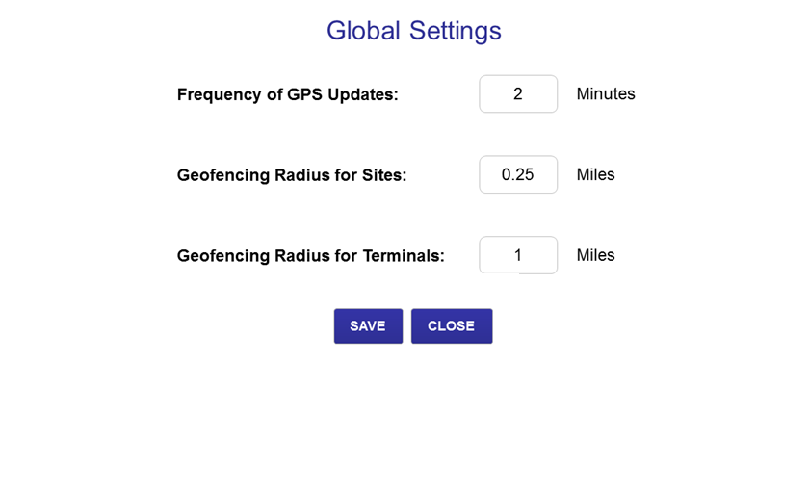
Global Settings
Geo-fencing radius specified here will be used as default values.

Slide 34
Integrations
Q&A
Thank You.

